Slide 1
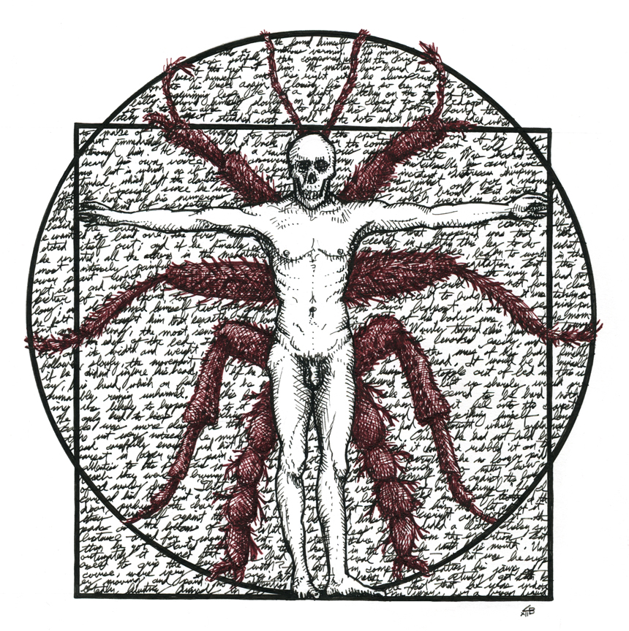
Franz Kafka’s
The Metamorphosis

Slide 2
How is ‘monstrosity’ created?
William Shakespeare: “Some are born great, some achieve greatness, and some have greatness thrust upon them.”
A modification: “Some are born monsters, some achieve monstrosity, and some have monstrosity thrust upon them.”
Discussion question: Which of these three options best applies to Frankenstein’s monster? Why?

Slide 3
Franz Kafka, “Prometheus” (c. 1917-23)
“There are four legends concerning Prometheus: According to the first, he was clamped to a rock in the Caucasus for betraying the secrets of the gods to men, and the gods sent eagles to feed on his liver, which was perpetually renewed. According to the second, Prometheus, goaded by the pain of the tearing beaks, pressed himself deeper and deeper into the rock until he became one with it. According to the third, his treachery was forgotten in the course of thousands of years, the gods forgotten, the eagles, he himself forgotten. According to the fourth, every one grew weary of the meaningless affair. The gods grew weary, the eagles grew weary, the wound closed wearily. There remained the inexplicable mass of rock. The legend tried to explain the inexplicable. As it came out of a substratum of truth it had in turn to end in the inexplicable.”

Slide 4
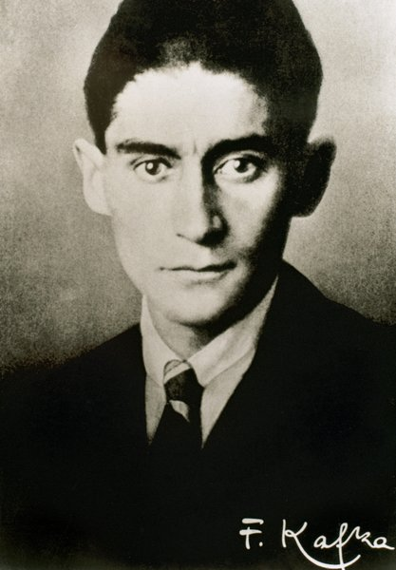
Franz Kafka
1883-1924
Born in Prague
German-speaking Jew
Worked in insurance
Wrote The Trial, “In the Penal Colony,” “A Hunger Artist”
Associated with modernism, existentialism

Slide 5
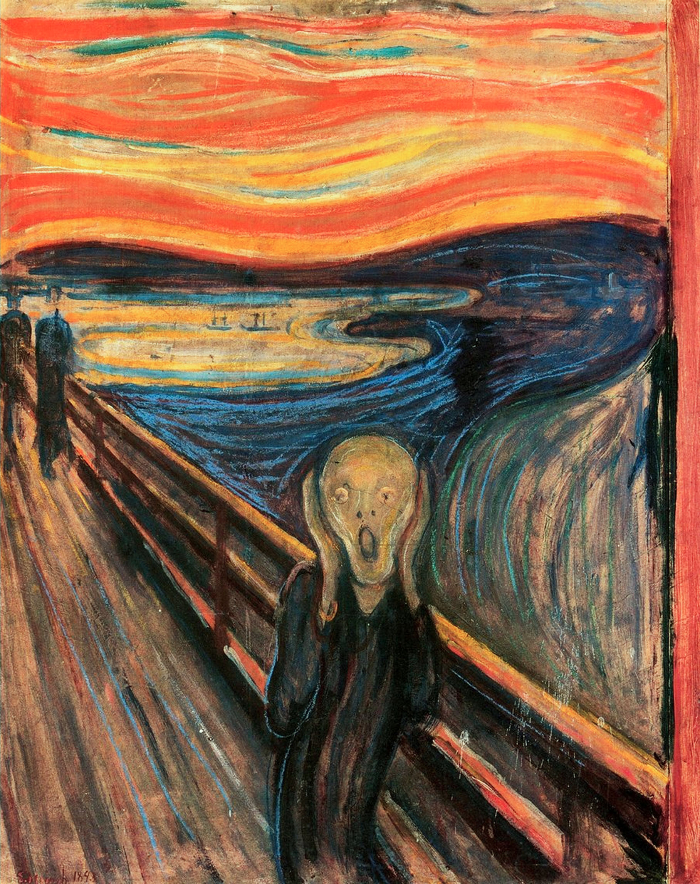
Franz Kafka
Recurring themes:
Alienation
Loneliness
Bureaucracy
Absurdity
Daddy issues
Violence
Transformation
Edvard Munch, The Scream (1893)

Slide 6

The Metamorphosis
German: Die Verwandlung
First published 1915
Slow to gain critical attention; now a classic
Cover of first edition

Slide 7
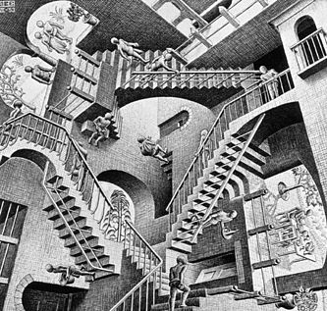
“Kafkaesque”
Marked by a senseless, disorienting, often menacing complexity. <Kafkaesque bureaucracies>
Marked by surreal distortion and a sense of impending danger.
M.C. Escher, Relativity (1953)

Slide 8
Bureaucratic Modernity
“Bureaucracy. Kafka’s world is characterized by features typical of urban modernity, such as the anonymity of crowds, the disorienting speed of traffic, high capitalist modes of industrial production, competitive business practices, and, foremost, infinite mechanisms of bureaucratic administration. In his professional life as a lawyer for a state-run insurance agency, Kafka was well acquainted with the often inhumane, unfeeling, and inefficient quality of bureaucratic apparatuses. The Austro-Hungarian monarchy, of which he was a citizen and by which he was employed, was infamous for its impenetrable, often inscrutable bureaucratic structures, so that the struggle with bureaucratic mechanisms was a part of Kafka’s everyday experiences.” –A Franz Kafka Encyclopedia

Slide 9
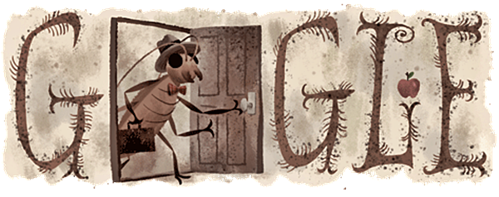

Slide 10
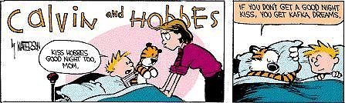
Bill Watterson, Calvin and Hobbes

Slide 11
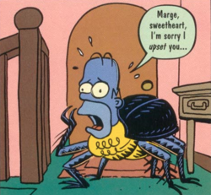
The Simpsons

Slide 12
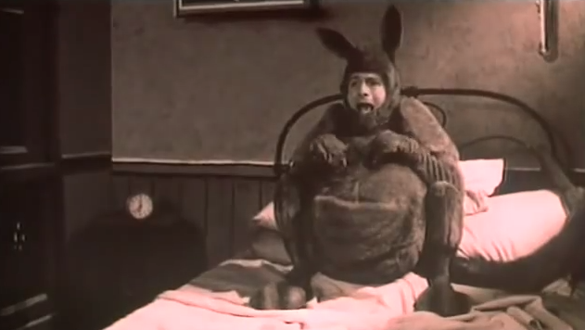
Peter Capaldi, Franz Kafka’s It’s a Wonderful Life (1993)

Slide 13
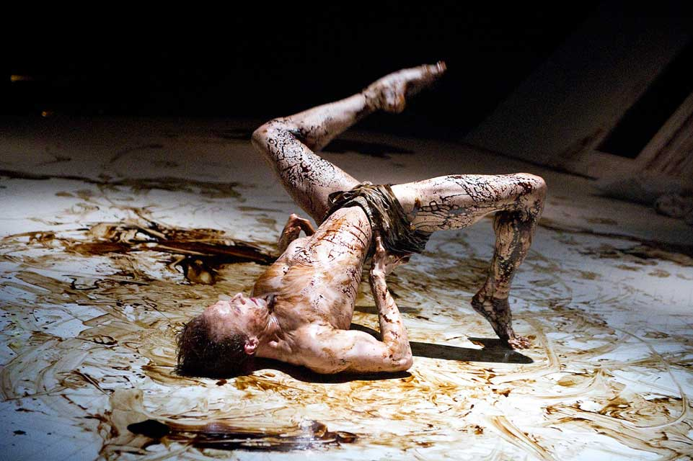
Ballet adaptation (Arthur Pita, Royal Opera House, 2013)

Slide 14
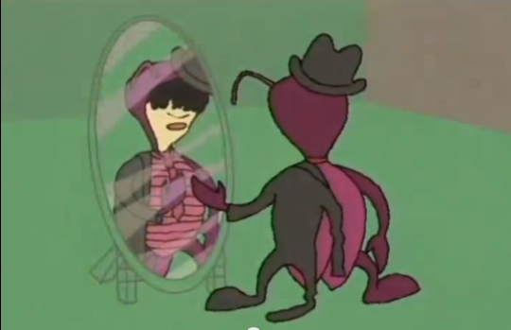
Home Movies

Slide 15
Signal Question
Consider Gregor Samsa’s role in The Metamorphosis. In what ways, if any, is he a “monster,” or monstrous? What might his monstrous transformation symbolize?
“Some are born monsters, some achieve monstrosity, and some have monstrosity thrust upon them.” Which applies to Gregor?

Slide 16
Group Work / Signal Question
In literature and film, monsters are often the physical manifestation of other qualities, acts, or ideas that are harder to pin down—taboos and taboo-crossings, notions of evil, danger, violence, etc. If we regard Gregor as a monster, then, what might Gregor’s transformation symbolize?

Slide 17
Close Read
“Gregor flinched when he heard his own [voice] in response: it was unmistakably his old voice, but now it had been infiltrated as if from below by a tortured peeping sound that was impossible to suppress—leaving each word intact, comprehensible, but only for an instant before so completely annihilating it as it continued to reverberate that a person could not tell for sure whether his ears were deceiving him.” (Part I, 26)

Slide 18
Discussion (Part I)
What do you think of Gregor’s response to his calamity? Why does he seem more concerned about his job and his family than what’s happened to him?

Slide 19
Narrative Types
Some basic types of “conflict”:
Human against Human
Human against Society
Human against Nature
Human against Self
Human against Metaphysical Force (e.g., God, the supernatural, etc.)

Slide 20
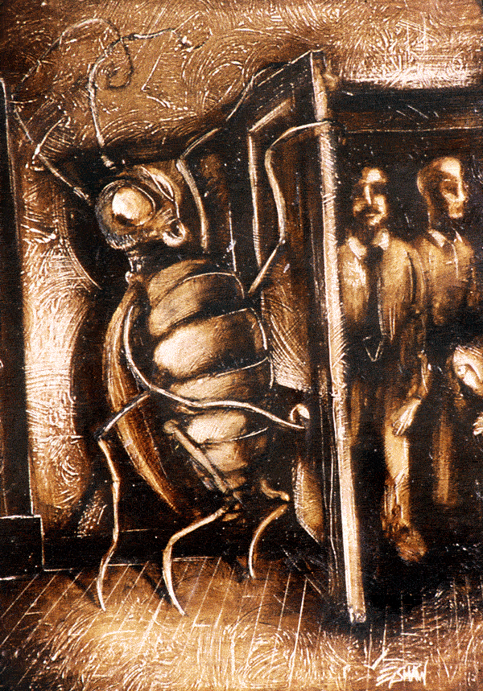
Frameworks for The Metamorphosis
Gregor vs. Himself
Body
Psyche
Gregor vs. Society
His family
His work
Gregor vs. Metaphysics
God (or absence of God)
Existential crisis
Absurdity

Slide 21
Signal Question
Can any of the seven “monster theses” we’ve studied help us understand Gregor’s ‘monstrosity’ so far? How so?
The Monster’s Body Is a Cultural Body
The Monster Always Escapes
The Monster is the Harbinger of Category Crisis
The Monster Dwells at the Gates of Difference
The Monster Polices the Borders of the Possible
Fear of the Monster is Really a Kind of Desire
The Monster Stands at the Threshold… of Becoming

Slide 22
Part II
The Metamorphosis begins with Gregor Samsa's transformation into “some sort of monstrous insect,” but it is also about how he transforms after that initial event. How would you say Gregor changes throughout the narrative (up through Part II)? How does his family change? What do these changes reveal about the characters?
Write for five minutes.

Slide 23
The “abject”
Merriam-Webster:
sunk to or existing in a low state or condition;
cast down in spirit – servile, spiritless;
expressing or offered in a humble and often ingratiating or obsequious spirit
More generally:
Something that is rejected by or disturbs social reason

Slide 24

The “abject”
French theorist, philosopher, and novelist Julia Kristeva
Associated with post-structuralism, postmodernism, psychoanalysis

Slide 25
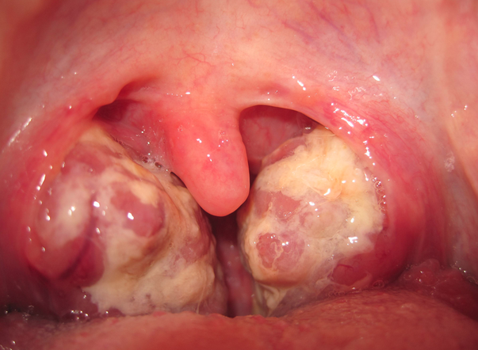
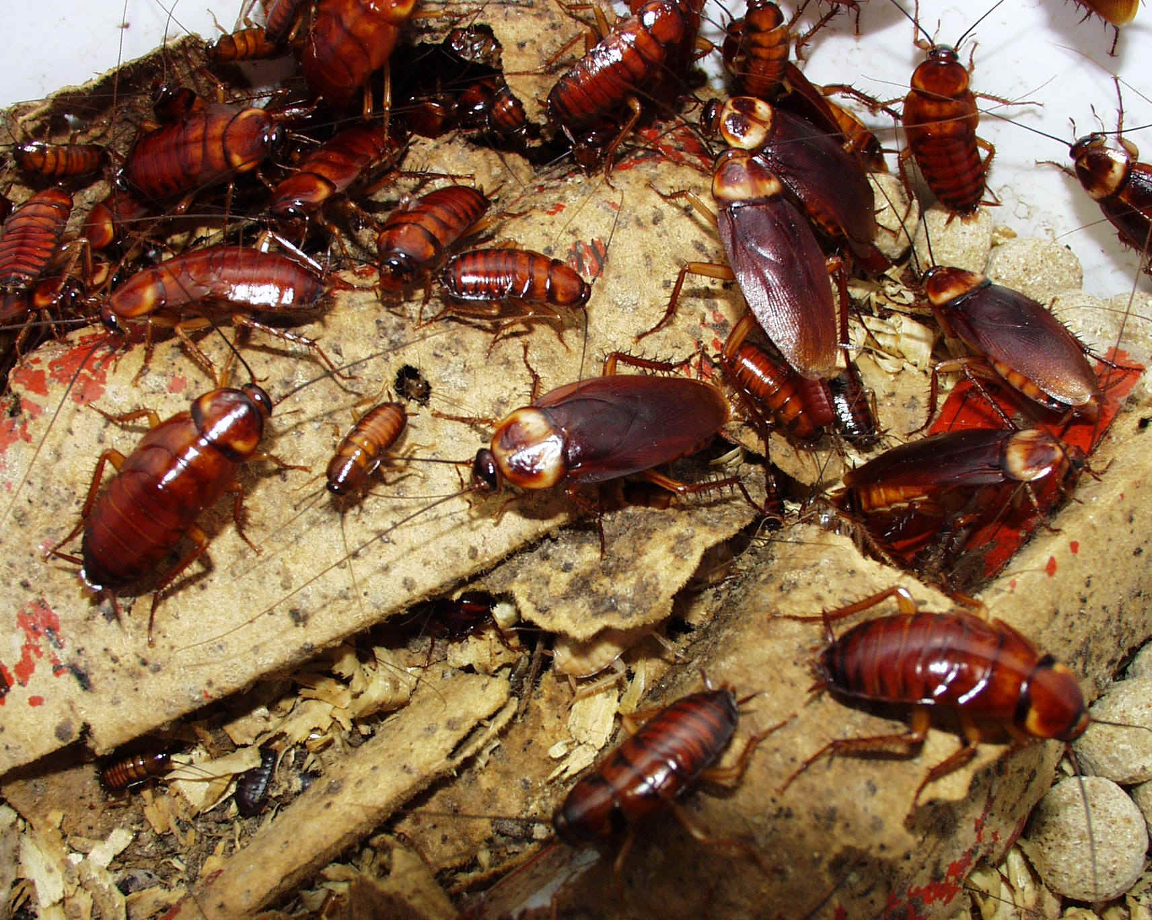
The “abject”
Examples:
Filth, garbage, trash
Bodily wastes
Urine, feces, hair, baby teeth, nail clippings, pus, snot, spit
Pests (rats, cockroaches)
Corpses

Slide 26
The “abject”
Culturally: This whole category represents that which society regards as dirty and unclean. In other words, these things are transgressive; they exist beyond what we deem normal or civilized society. For Kristeva, these things are not “gross” or repellent by nature. Rather, it is because society has long deemed them abject (unfit, unclean) that they are repellent to us. It is our negative associations with these phenomena that make us feel so disgusted and repelled when we encounter them in close proximity.

Slide 27
The “abject”
Psychoanalytically:
We “abject” an object or thing in order to consolidate and solidify our sense of self (identity).
The abject can thus be symbolic, banal, quotidian (e.g., food, a texture or pattern).
It is the product of transformation from self to not-self; from subject to abject.

Slide 28
The “abject”
The Abject vs. The Gross or Grotesque
NOT identical
Something can be gross without being abject, and vice versa
The abject can be banal, ordinary, everyday
Food
Textures
Smells
The abject is both subjective and culturally coded

Slide 29
Signal Question
Think about the concept of the “abject” that we’ve discussed, and consider its different aspects. Describe the treatment of “the abject” in The Metamorphosis. What is the source of the ‘abject’ in the novel, and why do the characters find it so disgusting? Are we meant to find it disgusting?

Slide 30
Re-Cap
What do you remember about the concept of the abject? Try to recall its different aspects, meanings, and contexts.

Slide 31
Aspects of the “Abject”
The Body: that which has been separated from the body and is considered radically other—the “not-self”
Social Status: a ‘low’ state; outcast; someone who occupies the lowest social position, or who is rejected from society

Slide 32
Signal Question
Now that you’ve finished the novel, where else do you see the abject at work? How is Gregor related to the abject? How are we supposed to feel about him and his plight?

Slide 33
Literature as ‘Symptom’
“Although Kafka does not offer anything like a causal account of Gregor’s transformation, he does suggest a number of possible systemic or structural features that help make sense of it. In other words, Gregor’s fall into abjection can be approached as a symptom whose fascinating presence serves as a displaced condensation of larger and more diffuse disturbances within the social field marked out by the text.”
–Eric Santner

Slide 34
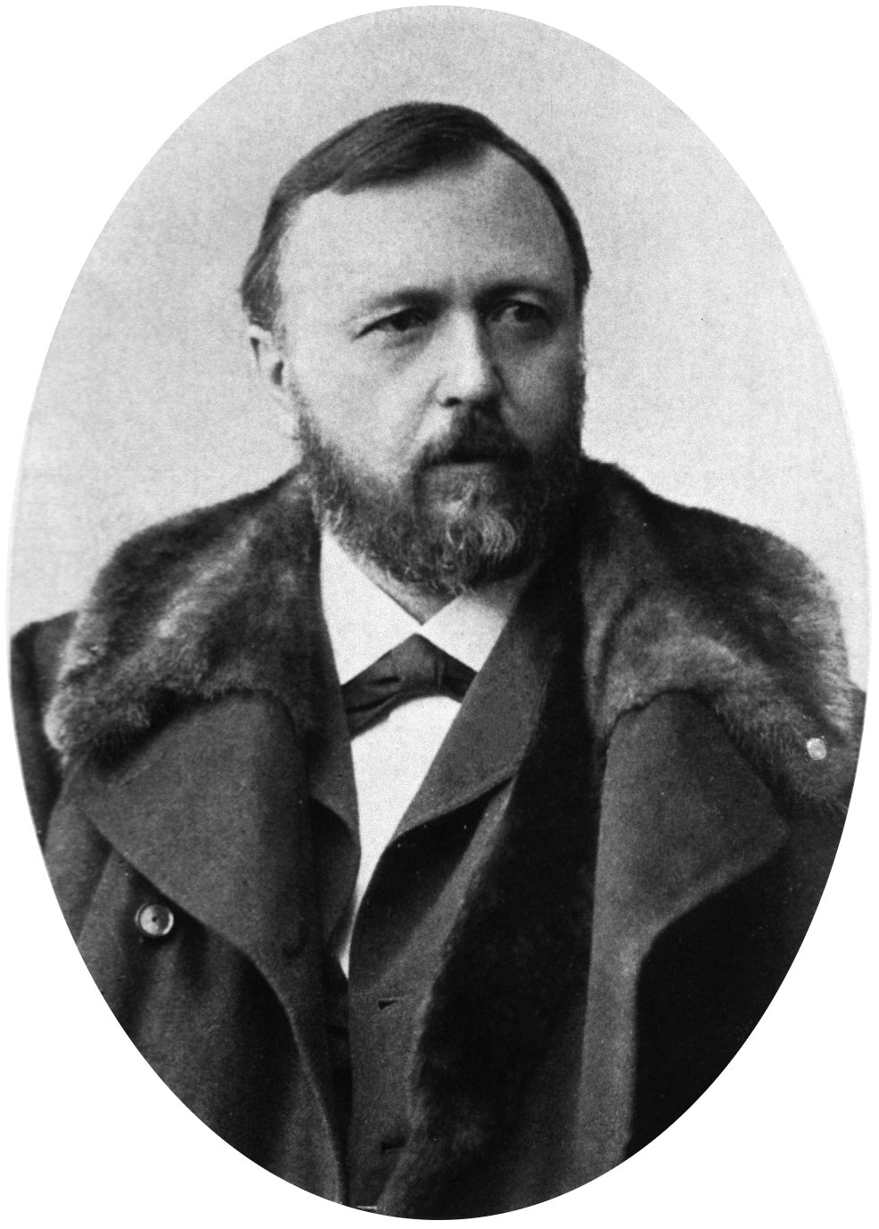
Richard von Krafft-Ebing (1840-1902)
“The scientific study of the psychopathology of sexual life necessarily deals with the miseries of man and the dark sides of his existence, the shadow of which contorts the sublime image of the deity into horrid caricatures, and leads astray aestheticism and morality.”
--Psychopathia Sexualis (1886)

Slide 35
Richard von Krafft-Ebing (1840-1902)
Psychopathia Sexualis (1886)
Studied ‘sexual pathology’:
Homosexuality
Bisexuality
Sadism, Masochism
Pedophilia
Masturbation

Slide 36
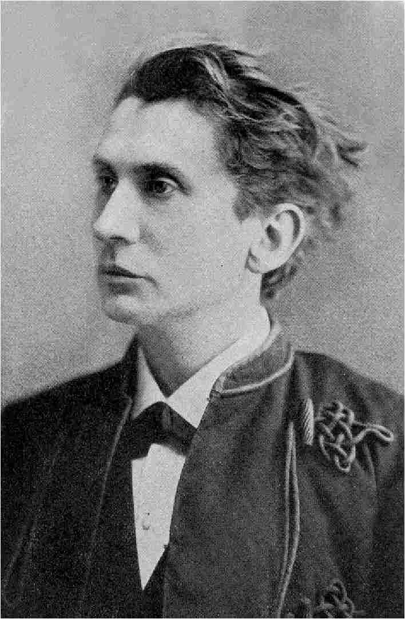
Leopold von Sacher-Masoch (1836-1895)
Namesake of “masochism” (coined by Krafft-Ebing)
Venus im Pelz (Venus in Furs), 1870
Fur as “fetish”

